Slide 1
Project Architecture
Team Nuggets:
Maximilian Christ, Jon Galindez, Caitlin Kwan, Jessica Lin, and Kenneth Lofstrom

Slide 2
Game Overview
Landscape Phone Orientation
Character has one dimensional movement
Up and down the screen
Moving obstacles traverse screen horizontally
Speed increases as game progresses
Confined to one dimensional “Lanes”
Endless scrolling game
Screen imagery remains stationary but character’s position resets
Goal is to pass as many “lanes” as possible

Slide 3
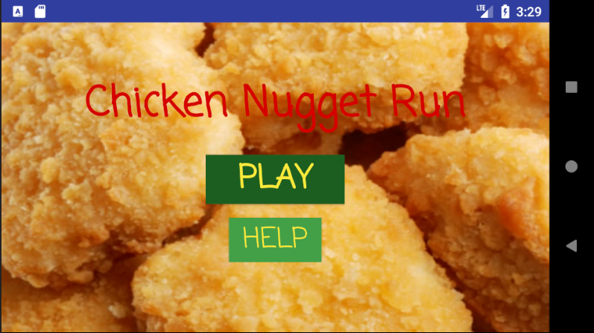
Gui Architecture
Start screen
Play button
Changes to next screen and game begins
Help button
Shows instruction screen

Slide 4
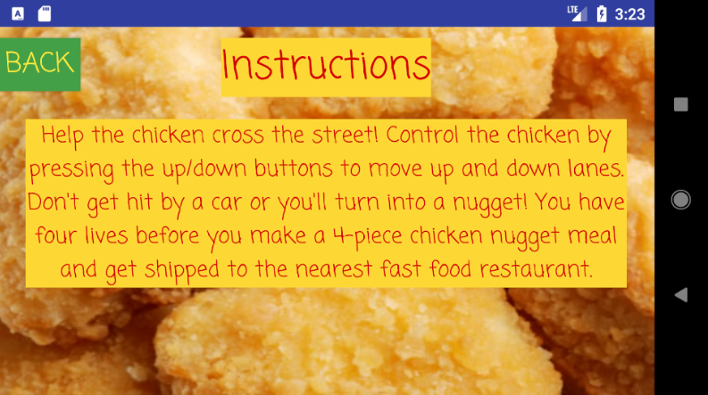
Gui Architecture
Help Screen
Shows instructions
Back button
Returns to start screen

Slide 5
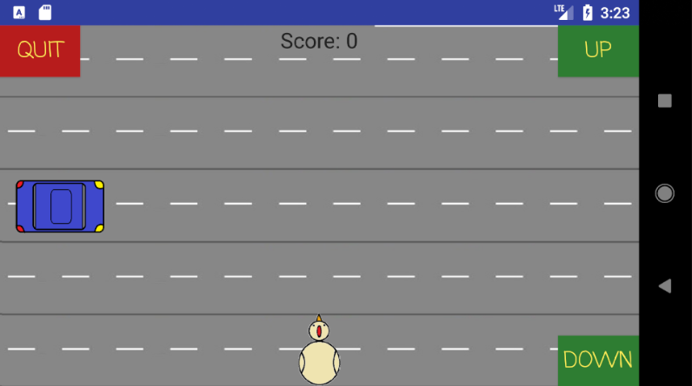
Gui Architecture
Game screen
5 “lanes” displayed
Character starts in the first lane
Up and down buttons
Move chicken forward to next or backwards to previous lane
Displays current score (based on lanes traversed)
Game window displays the next 5 lanes after the current five have been crossed
Cars are not present on the screen, but are in the back end (the car displayed is simply a picture and nothing more)

Slide 6
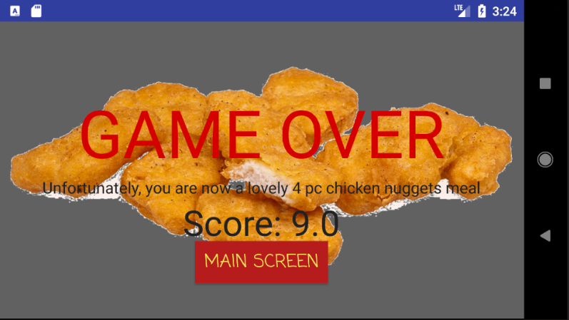
Gui Architecture
End screen
Appears after being hit by a car
Displays score
Main screen button
Returns user to the start screen

Slide 7
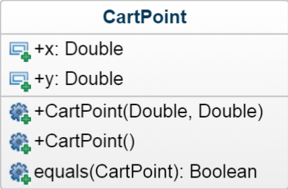
Back end Architecture
CartPoint class
Used by Player class and Car class to have coordinate locations

Slide 8
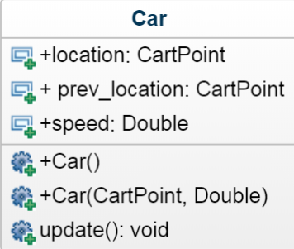
Back end Architecture
Car class
Used for the car objects moving across the screen
Each car operates within a single y coordinate representing the lane
X values change, moving car across lane
X values vary between 0 and 10, and when a car gets past either of these values, it resets to its starting position
Speed increases per lane
Every other lane, car moves opposite direction
Position is updated using time functions in Android Studio

Slide 9
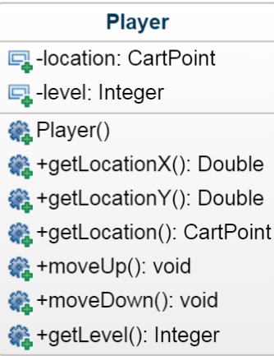
Back end Architecture
Player class
Used for the chicken character
Confined to a single x value
Y value is changed depending on input from GUI

Slide 10
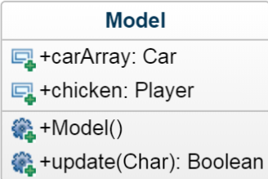
Back end Architecture
Model Class
Instantiates an array of cars for each of the 5 lanes
Instantiates the chicken
Updates the positons of the cars and the chicken

Slide 11
Interface Architecture
play_screen.xml
Uses all previous classes
Handles input from GUI and passes it to the back end classes using button call back functions
Retrieves data from back end classes to use in GUI

